Slide 1
University of Alaska Southeast
Welcome
UA Board of Regents, September 2012
Dr. Rick Caulfield, Provost
Juneau, Ketchikan, Sitka

Slide 2
University of Alaska Southeast
UAS MISSION
Student learning enhanced by
faculty scholarship, undergraduate research and creative activities,
community engagement, and the cultures and environment of Southeast Alaska.

Slide 3
University of Alaska Southeast
UAS VALUES
EXCELLENCE—continuous improvement
DIVERSITY—respect & understanding
ACCESS—innovative & inviting
COLLABORATION—dynamic partnerships
SUSTAINABILITY—educating for the future
STEWARDSHIP—responsible & accountable

Slide 4
University of Alaska Southeast
UAS CORE THEMES
STUDENT SUCCESS
TEACHING AND LEARNING
COMMUNITY ENGAGEMENT
RESEARCH & CREATIVE EXPRESSION

Slide 5
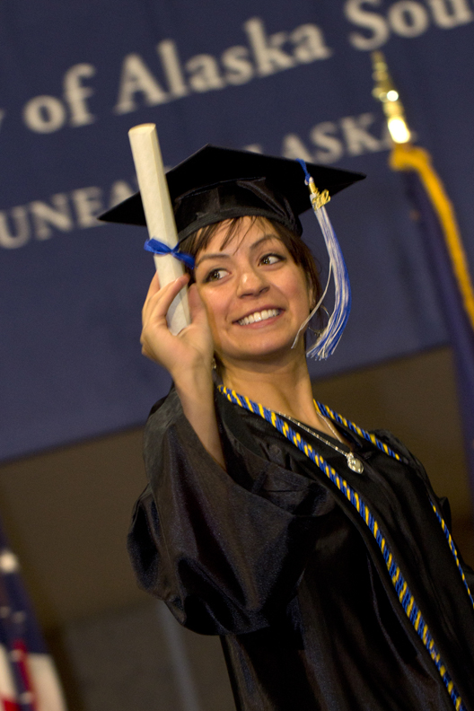
University of Alaska Southeast
STUDENT SUCCESS
What is it?
Confidence
Competence
Juneau Commencement 2012

Slide 6
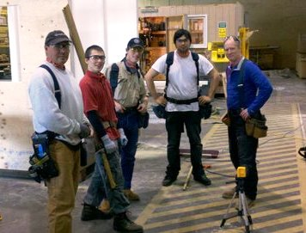
University of Alaska Southeast
STUDENT SUCCESS
Overcoming obstacles
Developing mastery
Creating a livelihood
UAS Sitka Campus

Slide 7
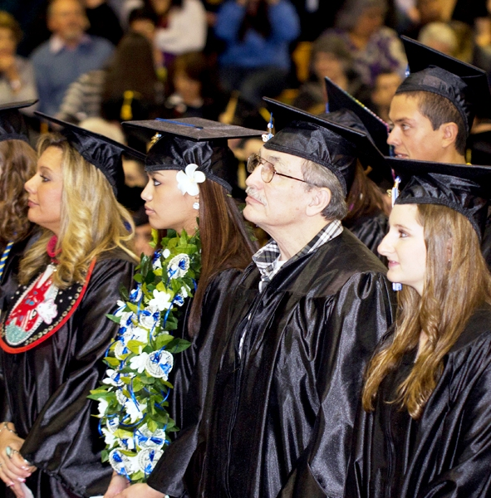
University of Alaska Southeast
STUDENT SUCCESS
Becoming a
lifelong learner
Giving back

Slide 8
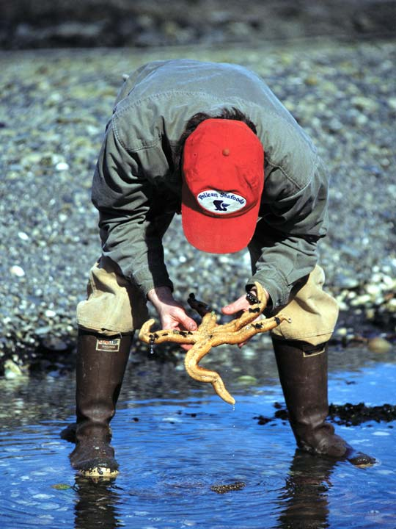
University of Alaska Southeast
TEACHING & LEARNING
Active, engaged learning
Place-based learning

Slide 9
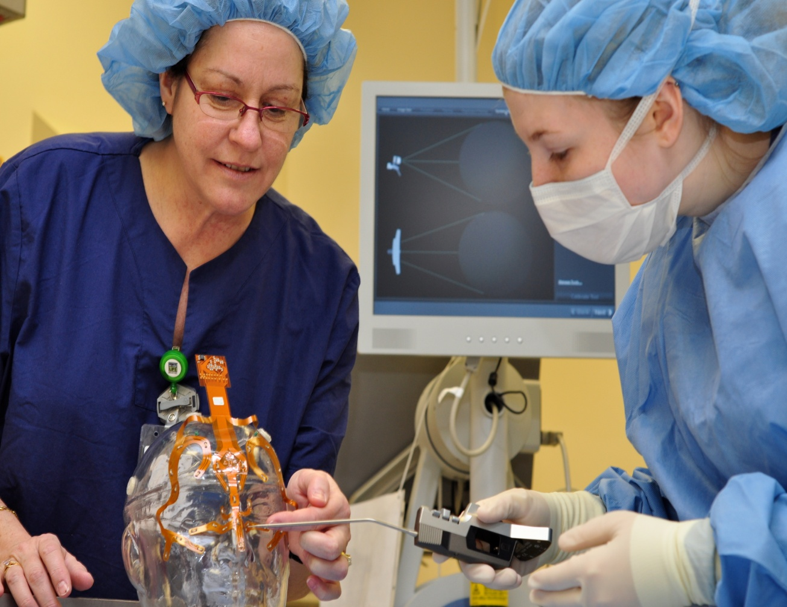
University of Alaska Southeast
TEACHING & LEARNING
Supportive learning environments
Setting high
expectations

Slide 10
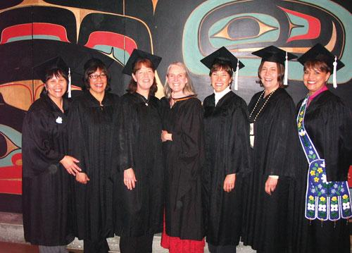
University of Alaska Southeast
TEACHING & LEARNING
Global
awareness
Knowledge of
arts, cultures & languages

Slide 11
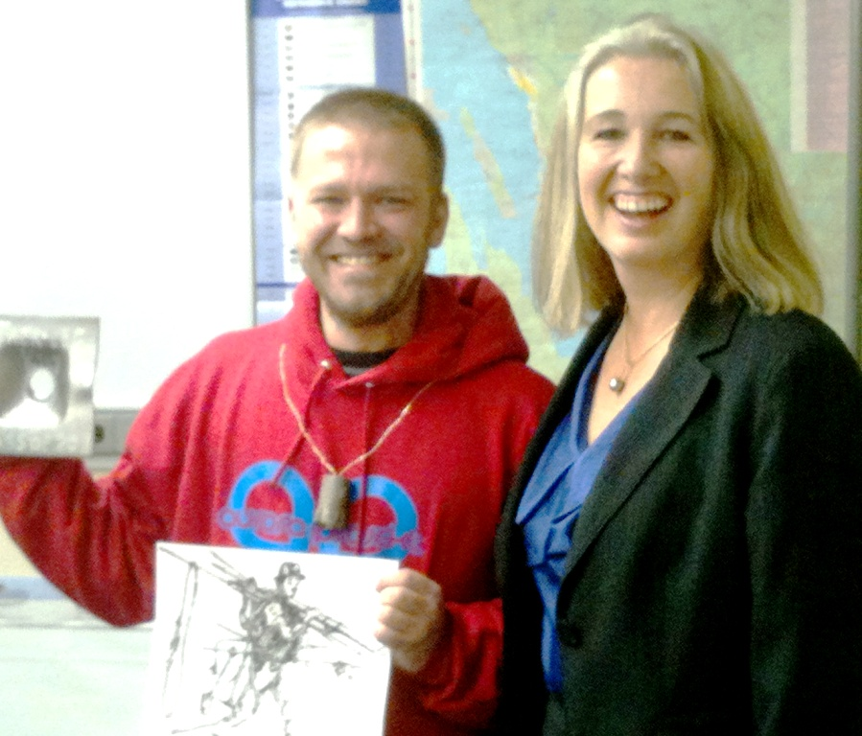
University of Alaska Southeast
COMMUNITY ENGAGEMENT
Meeting community needs
High demand
occupations
UAS Center for Mine Training
Representative Cathy Munoz

Slide 12
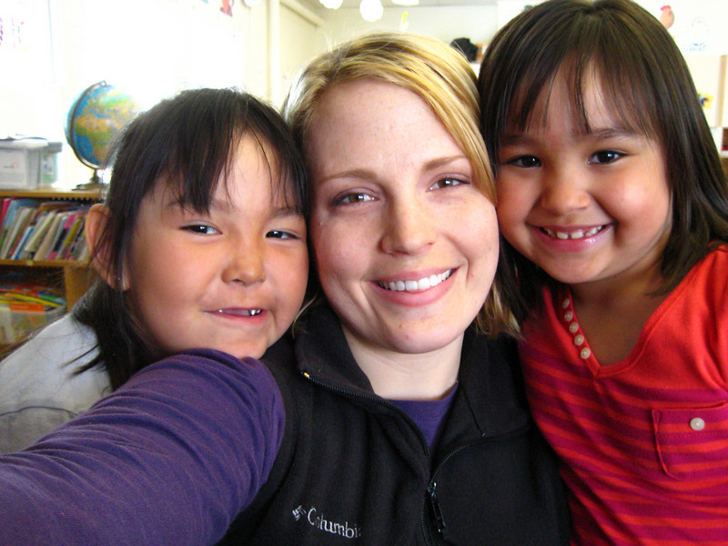
University of Alaska Southeast
COMMUNITY ENGAGEMENT
Service to others
Creating a better Alaska for our children

Slide 13
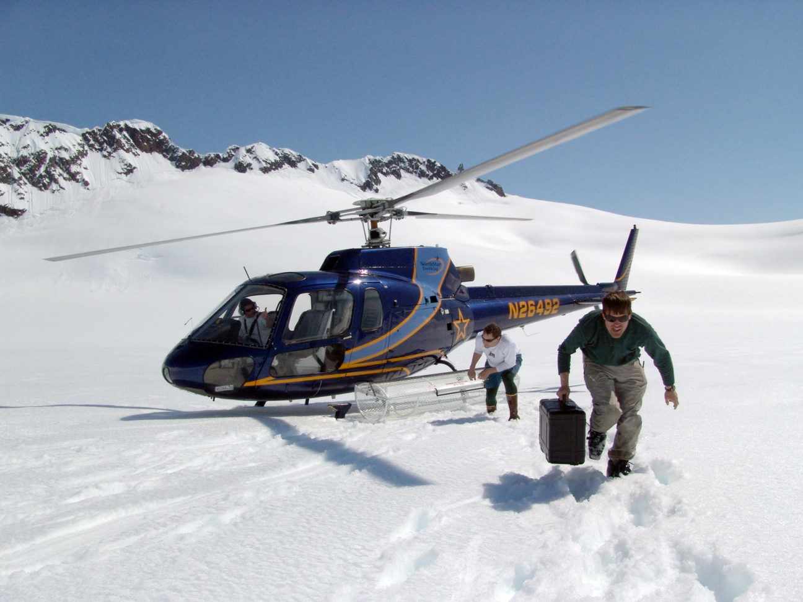
University of Alaska Southeast
RESEARCH & CREATIVE EXPRESSION
Creating new knowledge and insight

Slide 14
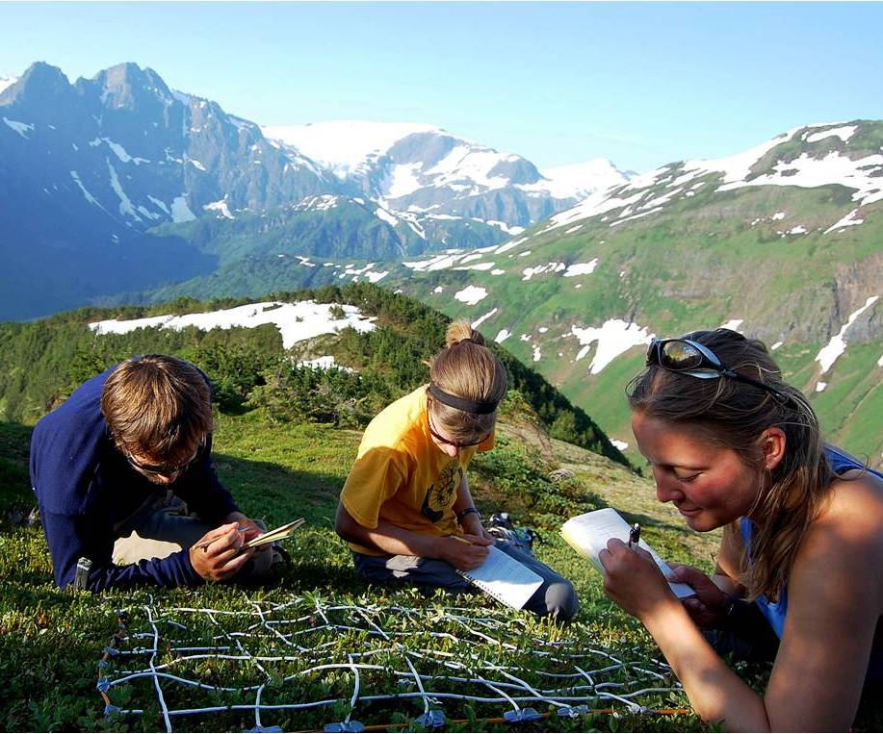
University of Alaska Southeast
RESEARCH & CREATIVE EXPRESSION
Engaging students in the process of discovery
Encouraging creativity

Slide 15
University of Alaska Southeast
UAS CORE THEMES
ALIGN WITH UA STRATEGIC DIRECTION
UAS CORE THEMES
Student Success
Teaching and Learning
Community Engagement
Research/Creative Expression
SDI THEMES
Student Achievement
Productive Partnerships
K-12 & Industry
Research & Development to Build and Sustain Alaska’s Growth
Accountability

Slide 16
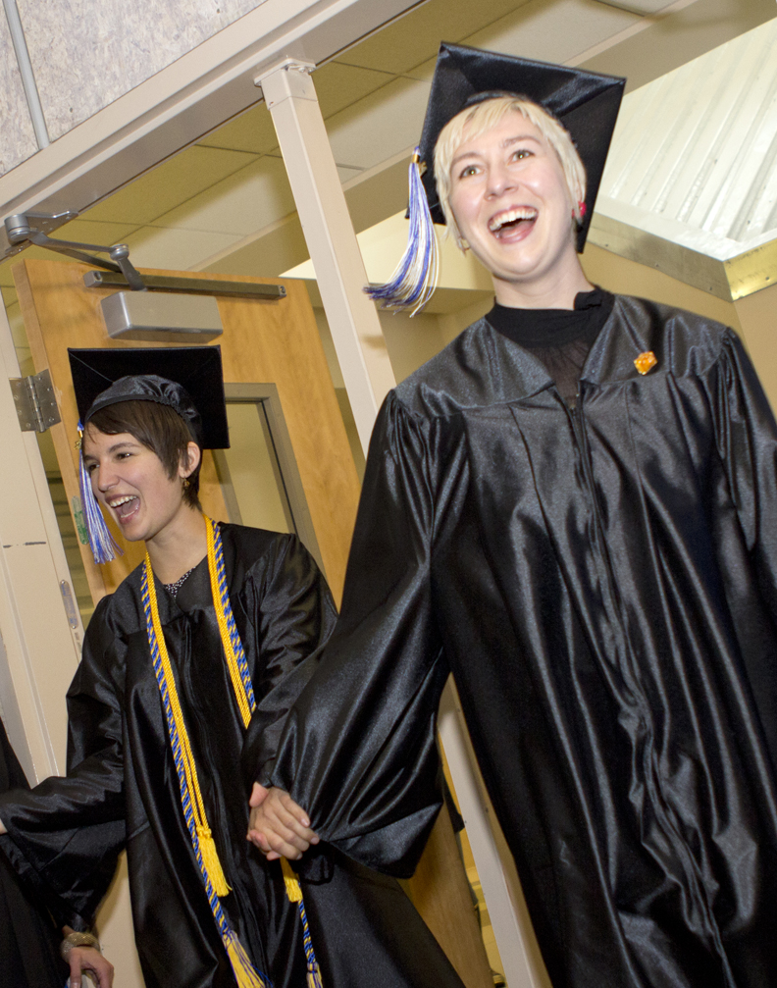
University of Alaska Southeast
HOW ARE WE DOING?
Record Number of Graduates in AY11-12
493 grads
UP 16%

Slide 17
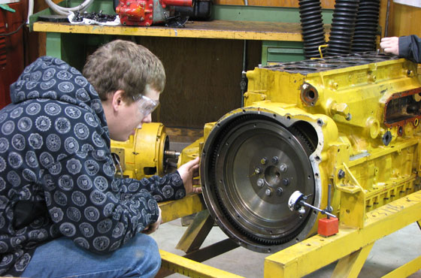
University of Alaska Southeast
HOW ARE WE DOING?
More Graduates in High Demand Occupations
UP 7.9%

Slide 18
University of Alaska Southeast
HOW ARE WE DOING?
Admitted UA Scholars
UP 21.5%
Enrolled Graduate Students
UP 3.8%
Notes:
As of 9/20/12

Slide 19
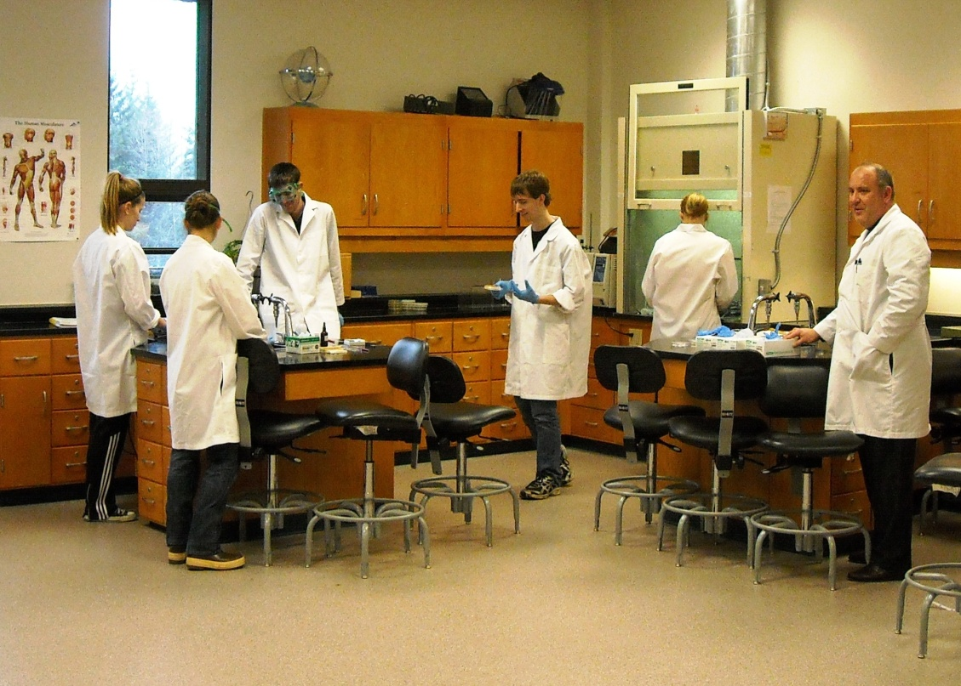
University of Alaska Southeast
HOW ARE WE DOING?
Undergraduate retention &
persistence
UP 3.2%
UAS Ketchikan Campus

Slide 20
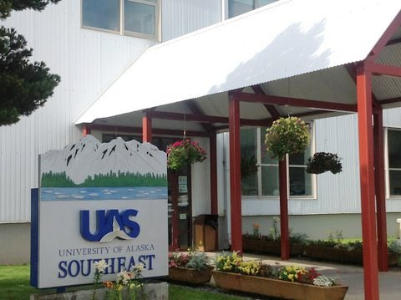
University of Alaska Southeast
HOW ARE WE DOING?
Non-credit offerings
UP 15.2%
Student tuition & fees
UP 4.8%
Research expenditures
UP 13.6%

Slide 21
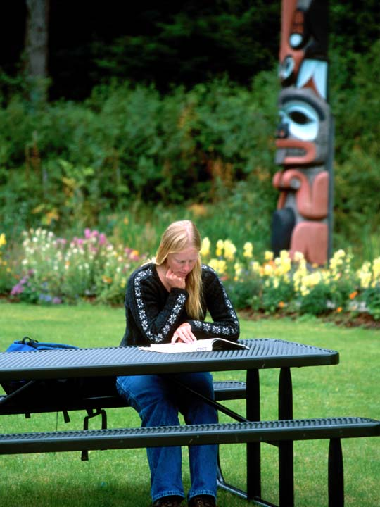
University of Alaska Southeast
ONGOING
CHALLENGES
Full-time students
DOWN 3.3%
Part-time students
DOWN 6.6%
Baccalaureate retention
DOWN 4.5%

Slide 22
University of Alaska Southeast
SO WHAT IS THE KEY TO
STUDENT SUCCESS?
It starts with all of us…
It is the quality of engagement with students by faculty and staff.

Slide 23
University of Alaska Southeast
THE GOOD NEWS….
STUDENTS COME TO UAS BECAUSE OF EXCELLENT FACULTY
84% are satisfied or very satisfied
with faculty
(2012 McDowell Group Student Retention Report)

Slide 24
University of Alaska Southeast
THE GOOD NEWS….
STUDENTS COME TO UAS BECAUSE OF EXCELLENT STAFF
Three-quarters of all students cited “responsiveness of staff to student needs”
as a highlight of their UAS experience
--McDowell Group 2012

Slide 25
University of Alaska Southeast
CHALLENGES & OPPORTUNITIES
Flat budgets—quality advising and retention are key
New resources will come from within
Declining federal funding
Increasing scrutiny & accountability
Small university with personalized approach
Great opportunities for active, engaged learning
Expanding technology-enhanced learning
Building on the distinctive assets of Southeast Alaska

Slide 26
University of Alaska Southeast
LOOKING AHEAD
Focus on our mission: student learning & success
Academic excellence: Program Reviews & assessments
Successful NWCCU accreditation Year 3
Improving student retention & timely completion
Aligning with K-12 partners
Improving strategies for college readiness
Community partnerships & workforce development

Slide 27
University of Alaska Southeast
PRESENTERS
Dean Deborah Lo, UAS School of Education
Ronalda Cadiente-Brown, PITAAS (Preparing Indigenous Teachers and Administrators for Alaska’s Schools) and Jasmine Jackson (Village Teachers)
Dean Marsha Sousa, UAS Vice Provost for Research
Paul Brewster, Assistant Station Director, USDA Forest Service
Pacific Northwest Research Station
Rick Edwards, Lead Scientist, USDA Forest Service
Héen Latinee Experimental Forest, Juneau, AK
Dean Sousa, UAS School of Arts & Sciences
Assistant Professor Xh’unei Lance Twitchell
Nae Tumulak, UAS undergraduate student

Slide 28
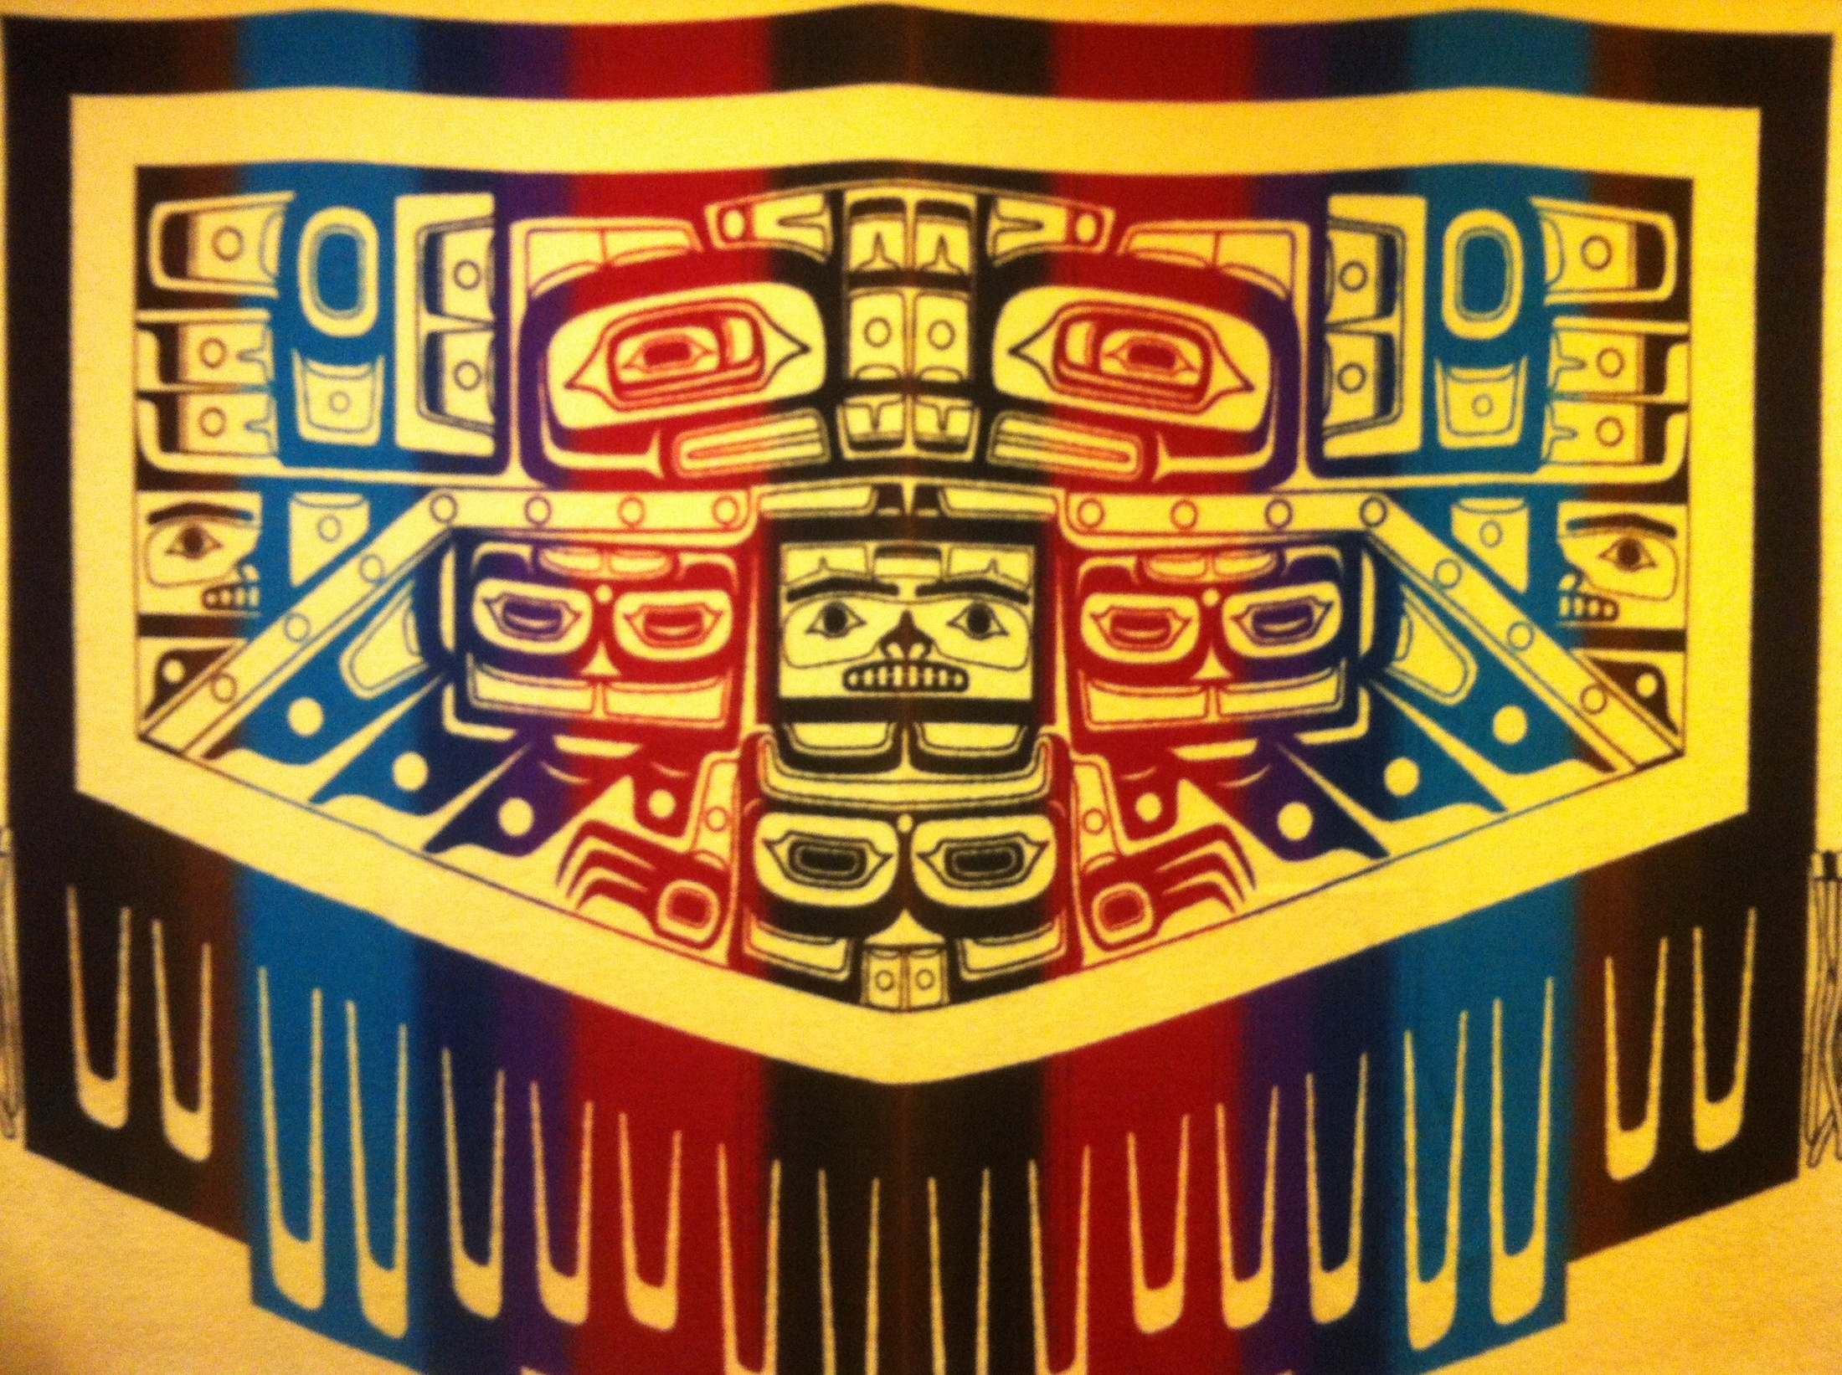
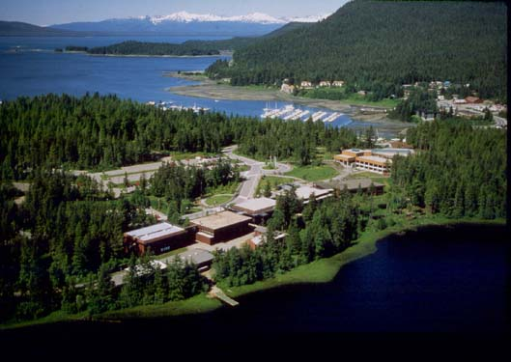
Native Student Success at the
University of Alaska Southeast
Presented by:
Ronalda Cadiente Brown, PITAAS Director
Jasmine Jackson, Village Teacher Director

Slide 29
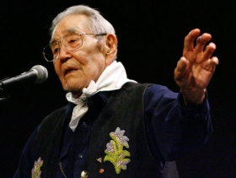
Dr. Walter Soboleff
(1908 – 2011)
Kaajaakwti, T’aawchan, L’eeneidi
This year, we are rededicating a building to Dr. Soboleff. We honor his wisdom, leadership, and advocacy for culture, traditions, and education.

Slide 30
Native Student Success at the University of Alaska Southeast
Preparing Indigenous Teachers and Administrators for Alaska’s Schools. (Funding Source: U.S. Department of Education PR#S356A110035)
- Scholarships
- Native and Rural Student Center
- Wooch.een
2. Village Teacher Grant. (Funding Source: U.S. Department of Education PR#S299B110002-12)
-- Scholarships
- Induction
- Research

Slide 31
Preparing Indigenous Teachers & Administrators for Alaska Schools (PITAAS)
Goals:
Increase Alaska Native teachers and administrators in Alaskan schools (Kindergarten-High School)
Address the shortage of Alaska Native teachers (less than 5% of the teaching force).
Scholarships for AK Native students
Provide support services to students in the program
Provide cultural learning opportunities

Slide 32
Village Teacher Grant
Goals:
Increase the number of high qualified Alaska Native educators in tribal communities by at least 25.
Increase tribal capacity to build support for local educator candidates after federal funding ends.
Program Support:
Provide support and resources to cohorts via distance.

Slide 33
Village Teacher Grant Awards
Graduate Student Cohorts
16 M.Ed. Reading Specialist
11 M.Ed. Mathematics Specialist
2 M.Ed. Educational Leadership (2013-2014)
Tuition and books
Stipend and child care support for full time students

Slide 34
PITAAS Native Student Support
Services & Activities
Scholarships
Foundations/Native Education Class
Mentoring
Tutoring
Native and Rural Student Center
Wooch.een
Faculty Seminars/Cultural Infusion

Slide 35
Current Student Summary
Preparing Indigenous Teachers and Administrators for Alaska Schools
2012 Graduates 12
PITAAS Students 41
Elementary BA 12
Secondary BA 9
M.A.T Elementary 5
Masters of Arts in Education 15
Village Teacher Grant Students
M.Ed. Reading 16
M.Ed Mathematics 11
M.Ed Educational Leadership 2
(Recruitment for 2013-2014 cohort)

Slide 36
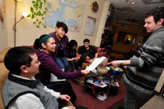
Native and Rural Student Center
Purpose:
Provides Native Alaskan students with a campus "home base" where they feel welcome and at home.
Allows them to observe role models, interact with peers, and receive encouragement to adjust to and succeed in the UAS environment while helping them to maintain a sense of their own.
Plans and implements culturally relevant activities on the university campus and in the community.

Slide 37
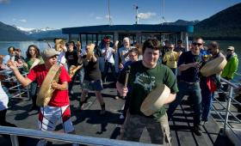
Cultural Activities
Wooch.een Club
Traditional Foods
Oratory competition
NRSC home away from home
Native History Month
Spoken Word
Gathering of the Drums
Native Graduation Celebration
Etc..

Slide 38
Gunalchéesh to the following
for making this presentation possible:
The Aakw’ Kwáan
The UAS Community and Chancellor Pugh
U.A. Department of Education

Slide 39
University of Alaska Southeast
PRESENTERS
Dean Deborah Lo, UAS School of Education
Ronalda Cadiente-Brown and Jasmine Jackson
Dean Marsha Sousa, UAS Vice Provost for Research
Paul Brewster, Assistant Station Director, USDA Forest Service
Pacific Northwest Research Station
Rick Edwards, Lead Scientist, USDA Forest Service
Héen Latinee Experimental Forest, Juneau, AK
Dean Sousa, UAS School of Arts & Sciences
Assistant Professor Xh’unei Lance Twitchell
Nae Tumulak, UAS undergraduate student

Slide 40
University of Alaska Southeast
PRESENTERS
Dean Deborah Lo, UAS School of Education
Ronalda Cadiente-Brown and Jasmine Jackson
Dean Marsha Sousa, UAS Vice Provost for Research
Paul Brewster, Assistant Station Director, USDA Forest Service
Pacific Northwest Research Station
Rick Edwards, Lead Scientist, USDA Forest Service
Héen Latinee Experimental Forest, Juneau, AK
Dean Sousa, UAS School of Arts & Sciences
Assistant Professor Xh’unei Lance Twitchell
Nae Tumulak, UAS undergraduate student

Slide 41
University of Alaska Southeast

Slide 42
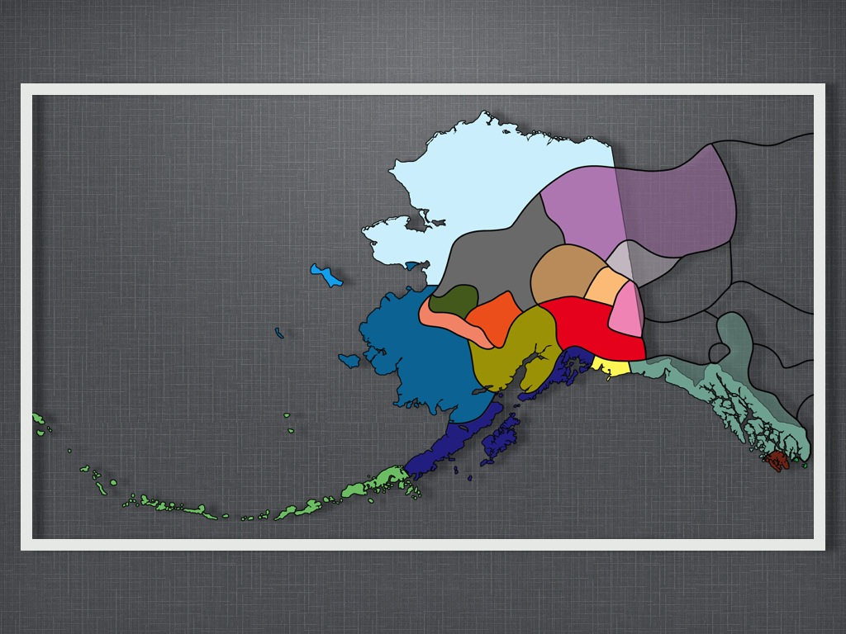

Slide 46
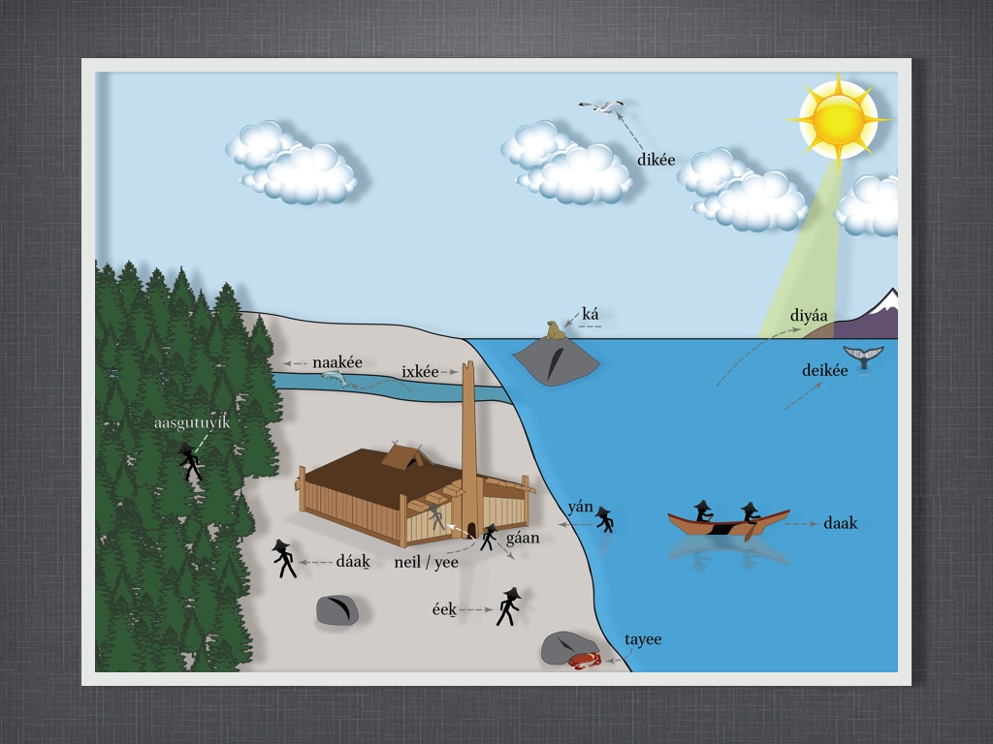

Slide 50
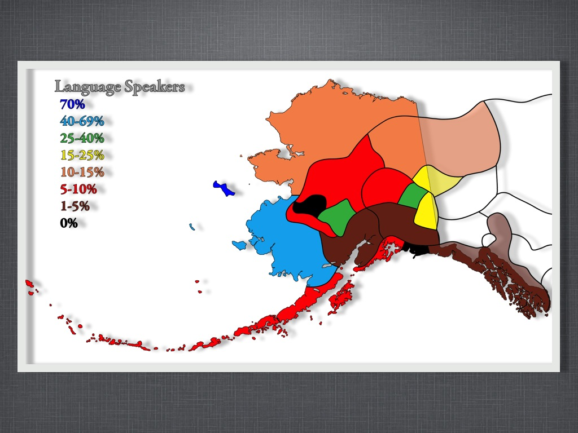

Slide 52
University of Alaska Southeast
Thank You!
Gunalchéesh!

